Slide 1

BMRAM Project
Overview

Slide 2
Agenda
BMRAM Tracker Update
Work Request
Asset Induction Request
NCR Reports
SMRY Reports

Slide 3
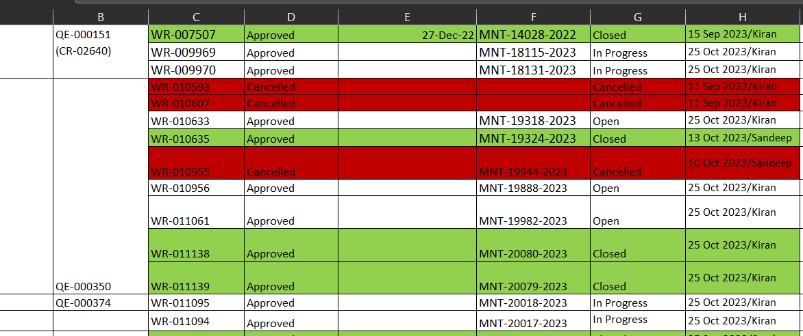
BMRAM Tracker Update
Daily CR Numbers status update:

Slide 4
Work Request
Primary Asset
Request Type: | GMP
Assigned Department: | Engineering or Maintenance
Assigned To: | Scott
Location: | Elma Facility
Priority: | Minor or Major
Supporting Doc:
Asset Description:
Submission Comments: | Work record to connect Chiller lines for seven (7) HVAC units, Reference with CR-02768
Work Request Creation Template:

Slide 5
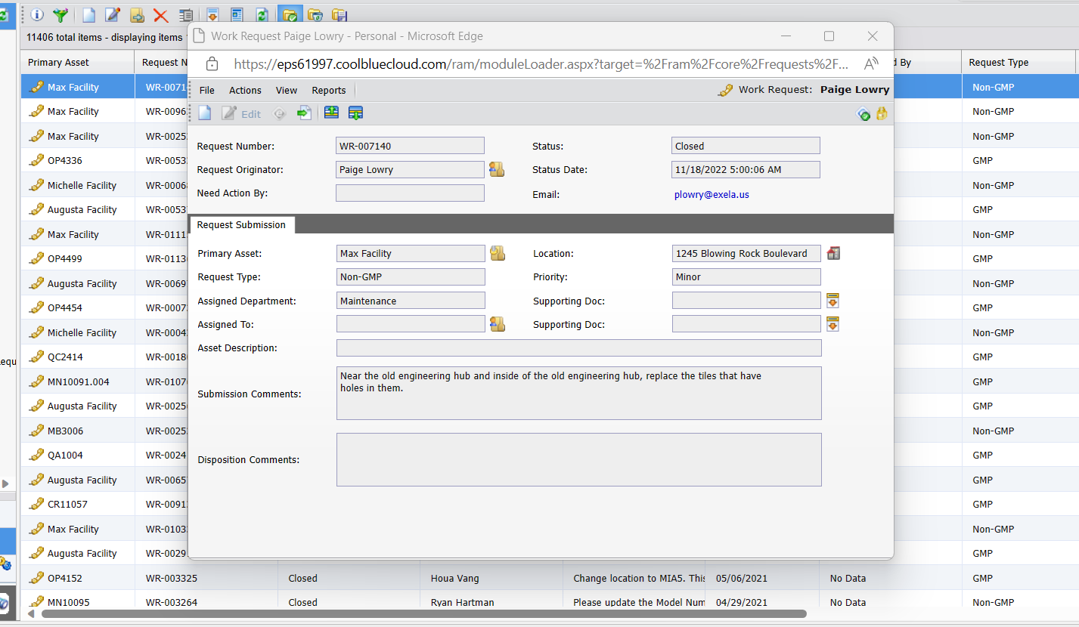
Work Request
Work Request Creation Template:

Slide 6
Asset Induction Request
Request Originator: | Spencer Devis
Manufacturer: | Wilco
Department: | Operations
Model Number: | NEO DPX
Serial Number: | S 1.3.0 / 21.0011
Location: | Elma (Exact Location)
Asset Description: | NEO DPX Inspection Machine
Asset Type: | Inspection Machine
Asset Owner: | Operation Department
Details: | Create AIR. Ref CR-02811
Asset Induction Request Template:

Slide 7
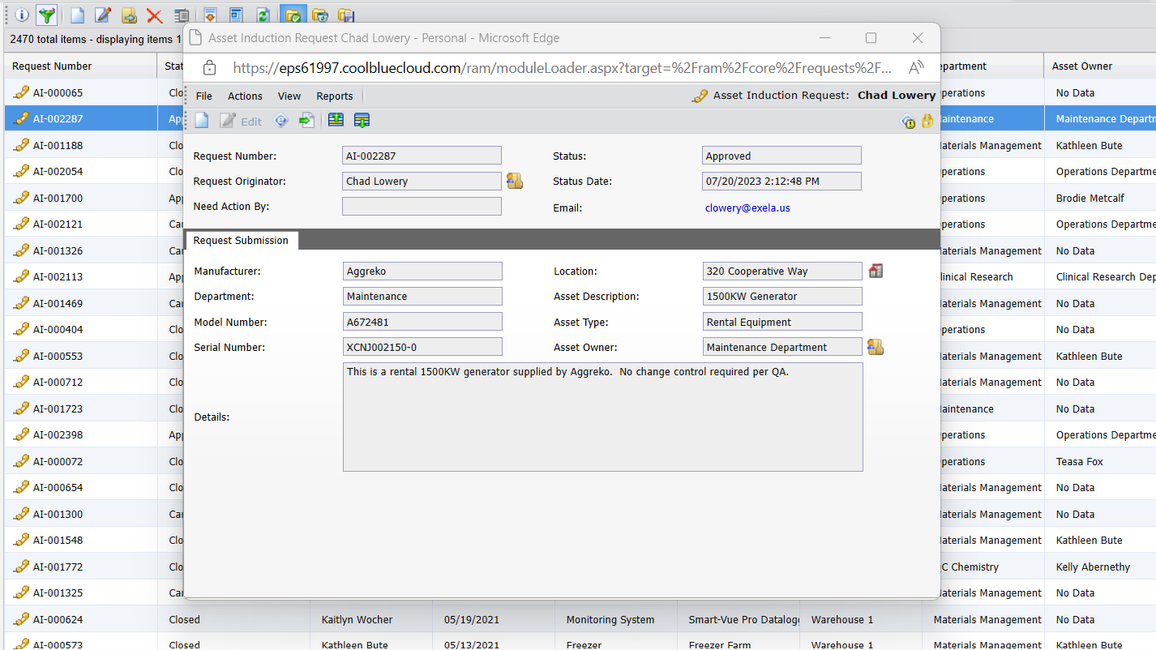
Asset Induction Request
Asset Induction Request Template:

Slide 8
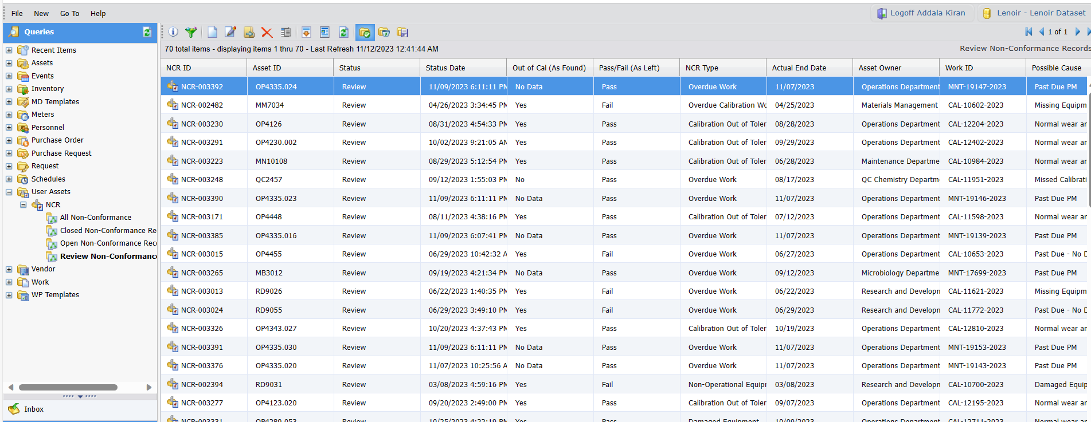
NCR Reports
NCR Data
Open/Review/Closed Status Reports

Slide 9
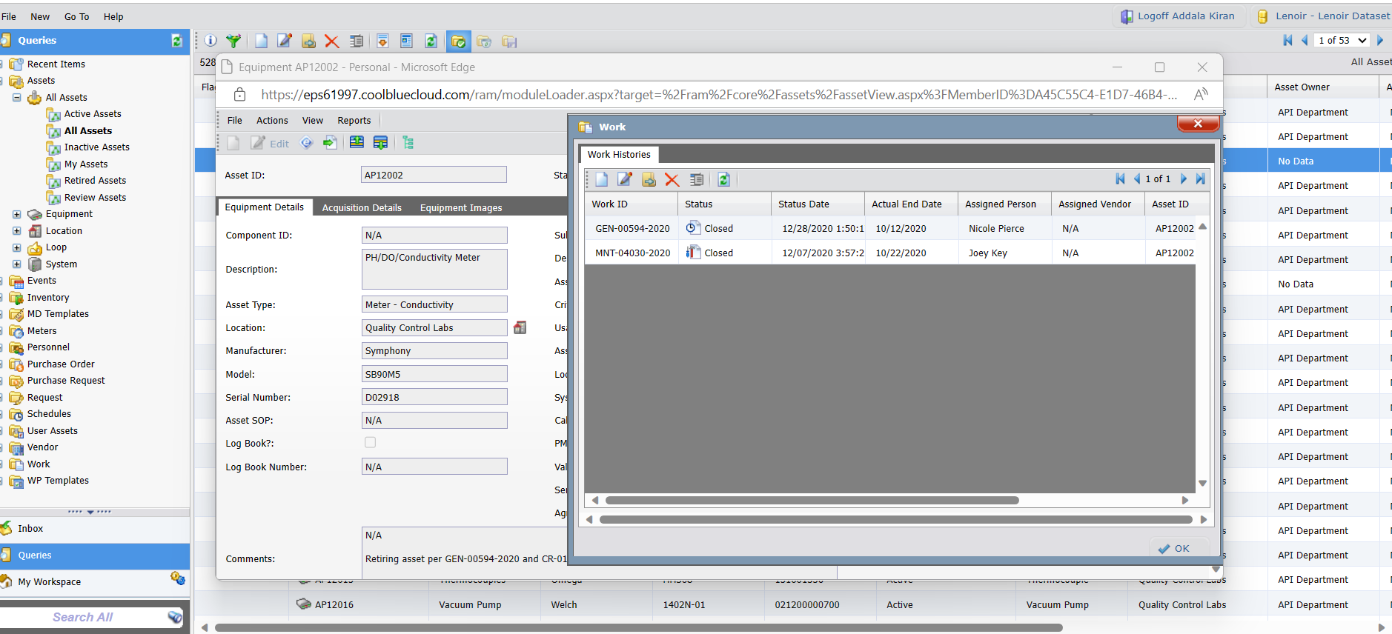
SMRY Reports

Slide 10

Questions?

Slide 11

Thank you

